Slide 1

Gokaraju Rangaraju Institute of Engineering and Technology (Autonomous) Department of Artificial Intelligence and Machine Learning Engineering
Enhanced Automated Word Formatter
Under the Guidance of:
Dr. M. Kiran Kumar,
Associate Professor, Dept of AIMLE
Presented by:
1. Mr. N. Krishna Kalyan (20241A6638)
2. Mr. A. Abhinav (20241A6605)
3. Mr. Samuel (20241A6647)

Slide 2
ABSTRACT
Researches face a lot of problem while documenting their Manuscripts. In absence of proper formatting, the research paper may get rejected, even if it has quality content. The aim of project is to create an application to streamline the process of transforming documents into various recognized academic or professional styles, ensuring consistency and precision. The proposed application is useful for a wide range of usecases, from Research papers to Academic Thesis, which effortlessly manages titles, headings, text, tables, figures, equations and also presents the content in an organized and professional manner. Additionally, it automates the handling of Citations and References, significantly enhancing the document preparation efficiently across various formatting standards. The proposed application is constructed by modifying the nodes of the document tree structure. With this versatile application, valuable time and effort can be saved while ensuring the documents adhere to the highest standards of formatting.

Slide 3
OBJECTIVES
To Implement a python-based word formatting tool which automates manual editing to save time and effort. ​​
Applying a pre-defined style to the categorized elements through manipulation of the Document Tree Structure.
To implement approaches for formatting text, images, and tables
To enable specific styling techniques for each element.

Slide 4
EXISTING APPROACHES (Literature Survey-Summary)
Existing approaches to automated word formatting include template-based systems that apply consistent styles using predefined templates, rule-based systems that utilize regular expressions or pattern-matching techniques for formatting specific elements, and machine learning-based methods that classify and format document components using trained models. Template-based systems offer ease of use and quick formatting but lack flexibility for diverse structures. Rule-based systems provide customization but can be complex to maintain and update. Machine learning methods offer advanced classification capabilities and adaptability but require extensive training data and computational resources to achieve high accuracy. Each approach has its strengths and limitations in terms of flexibility, ease of implementation, and handling of complex document structures.

Slide 5
LIMITATIONS of THE EXISTING APPROACHES
Rule-based systems, which use regular expressions or pattern-matching, can be tailored to specific needs but often falter with complex or irregular document layouts, especially when formatting images, tables, and text. They also need constant updates and maintenance to stay effective. On the other hand, machine learning-based methods, while more adaptable and capable of advanced classification, require vast amounts of annotated training data and significant computational power. These methods also struggle to accurately format embedded images and tables, which often have intricate and varied structures. These limitations highlight the challenges in achieving comprehensive and reliable automated document formatting.

Slide 6
SOFTWARE and HARDWARE REQUIREMENTS
Frontend Development | Software: Text Editor (e.g., Visual Studio Code, Atom, Sublime Text) and a Web Browser (e.g., Google Chrome, Mozilla Firefox) Hardware: Computer with a minimum of 4GB RAM and High-resolution display.
Backend Development | Software: Python: Install the latest version of Python >=3.8.0, Install the Django web framework and scikit-learn machine learning module supported by python. Hardware: Computer with a minimum of 8GB RAM and Adequate free storage >= 10gb to store project documents and database.

Slide 7
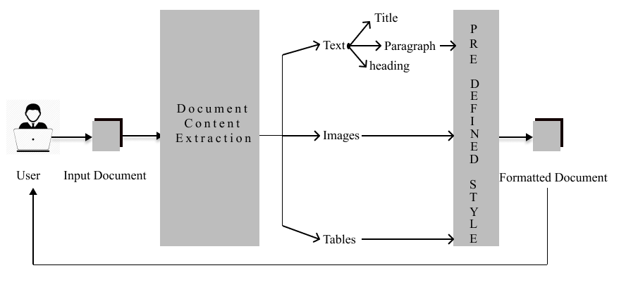
ARCHITECTURE DIAGRAM

Slide 8
MODULES and EXPLANATION
User Module
File Upload and Download: Enabling users to upload Word documents and download formatted documents.
Feedback: Allows users to send there feedback and suggestions on how well the document is formatted.

Slide 9
Input and Processing Module
File Upload Handling: Receiving and validating uploaded Word documents.
Data Extraction: Extracting data from Word documents, including text and document structure.
Data Preprocessing: Cleaning and formatting extracted data, removing extra spaces, and ensuring data consistency.

Slide 10
Predefined Style Application Module
Layout Adjustment: Ensuring that the document layout complies with research paper standards here Text, Images and Table is handled separately.
Style Consistency: Applying consistent styles throughout the document by using regular expressions.
Output Module
Formatted Document Generation: Generating a properly formatted Word document with the applied styles.
File Download Handling: Serving the formatted document to users for download.

Slide 11
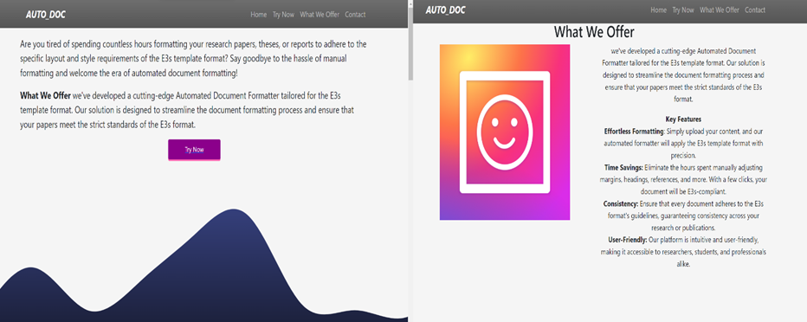
EXPERIMENTAL RESULTS
The above image illustrates how the user interface is provided to the user.

Slide 12
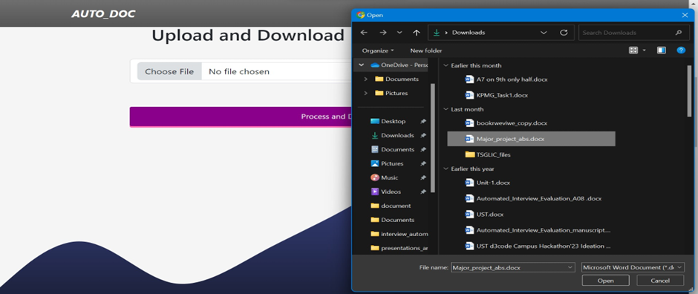
The above process shows how to upload a document file of the user.

Slide 13
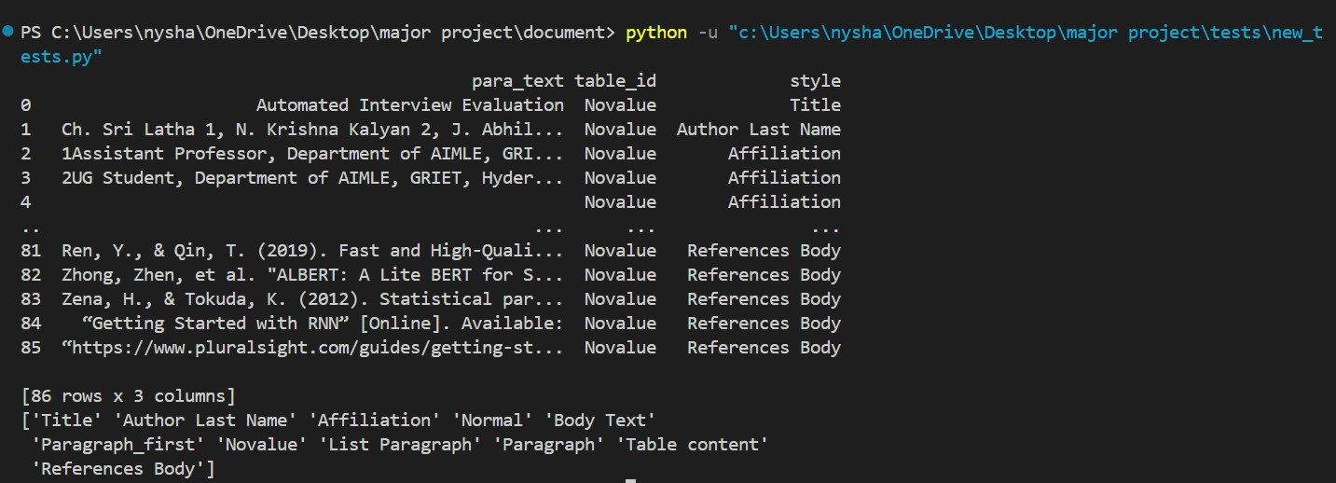
The above image is an intermediate process which demonstrates how the elements are classified internally within the document this is an illustration on how the elements are stored in words document object model.

Slide 14
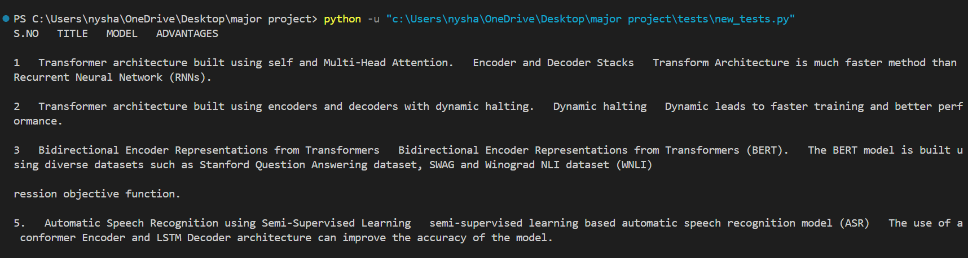
The above image is an intermediate process which demonstrates how the table data is extracted and stored in the form of a data frame so that a new required style can be applied to the table.

Slide 15
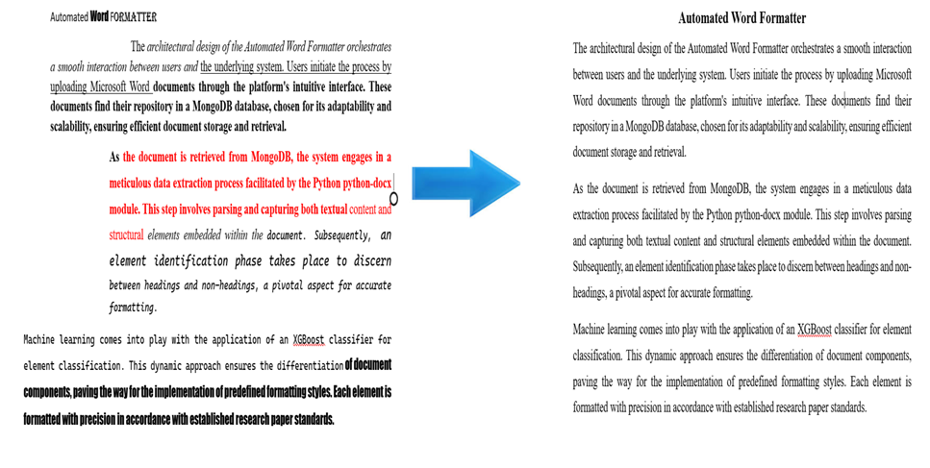
A sample output on how the project works taking the raw document and converting it into a Formatted document.

Slide 16
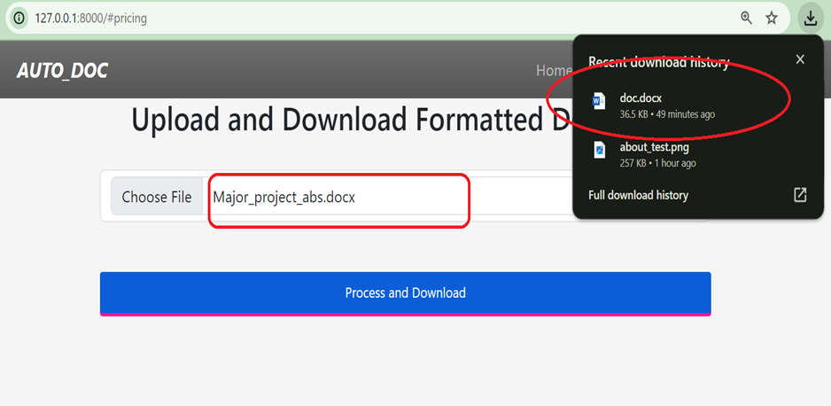
Once the document is uploaded the formatted document will be automatically downloaded as illustrated above.

Slide 17
ADVANTAGES OF THE PROPOSED METHOD
The proposed hybrid approach leverages the strengths of both Word Document Object Model (DOM) manipulation and an XGBoost classifier to enhance automated document formatting. By utilizing Word DOM manipulation, the system effectively analyzes the document structure and manipulates images and tables, ensuring accurate parsing of complex layouts. Simultaneously, the XGBoost classifier excels in identifying headings and non-headings, offering precise classification of document elements. This combination allows for a more robust and adaptable formatting process, capable of handling intricate structures and providing superior accuracy compared to traditional methods.

Slide 18
DISADVANTAGES OF THE PROPOSED METHOD
One downside of our hybrid approach is that it currently doesn't support multiple document formats. Right now, it may only work with a specific format E3S, leaving out some common document types that people often use. This limitation might make it challenging for users who deal with different types of files, requiring additional work to ensure compatibility with a wider variety of formats.

Slide 19
Conclusions
The Automated Word Formatter stands as a transformative solution, rendering document formatting a hassle-free. Users experience seamless formatting magic by effortlessly uploading their documents to the platform. This marks a significant shift, making the once tedious task of formatting documents a breeze. One of the standout features is the platform's commitment to delivering an effortless formatting experience. Users can achieve a polished and professional look for their documents without the need for intricate manual adjustments. The formatter streamlines the process, enabling users to channel their focus on the document's content rather than getting entangled in formatting intricacies. Consistency in style is a paramount achievement facilitated by the Automated Word Formatter. Fonts, alignments, and spacing are standardized, ensuring a cohesive and professional appearance across documents.

Slide 20
FUTURE ENHANCEMENTS
These advancements can be addressed ahead in future
Additional Document Formats: Extend support beyond DOCX to include other popular document formats, ensuring a broader user base.
Collaborative Editing: Implement collaborative editing features to enable multiple users to work on a document simultaneously.
Enhanced Error Handling: Improve error handling mechanisms to provide users with clear feedback in case of formatting issues or document errors.

Slide 21
REFERENCES
1. K. Chuvilin, "Machine learning approach to automated correction of LaTeX documents," in Proceedings of the Conference of FRUCT Association, 2016.
2. Oliveira, "Two algorithms for automatic document page layout," in Proceedings of the Eighth ACM Symposium, 2008.
3. N. Hurst, "Review of automatic document formatting," in Proceedings of the 9th ACM Symposium, 2009.
4. I. Nasser, "Web application for generating a standard coordinated documentation for CS students’ graduation project in Gaza universities," International Journal of Engineering and Information Systems (IJEAIS), vol. 1, no. 6, 2017.
5. G. Gange, "Optimal automatic table layout," in Proceedings of the 11th ACM Symposium, 2011.
6. M. Bilauca, "Automatic minimal-height table layout," INFORMS Journal on Computing, vol. 27, 2015.
7. J. Bateman, "Towards constructive text, diagram, and layout generation for information presentation," Computational Linguistics, vol. 27, 2001.
8. I. A. Bolshakov, "Text segmentation into paragraphs based on local text cohesion," Springer-Verlag, 2001.
9. Widiastuti, "Document image extraction system design," in Proceedings of the 3rd International Conference on Informatics, Engineering, Science, and Technology (INCITEST 2020), 2020.

Slide 22
10. "TableNet: Deep learning model for end-to-end table detection and tabular data extraction from scanned document images," in Proceedings of the International Conference on Document Analysis and Recognition (ICDAR), 2020.
11. Maud Ehrmann, "Named Entity Recognition and Classification in Historical Documents: A Survey," ACM Computing Surveys, vol. 56, no. 2, 2023.
12. Stefan Schweter, "FLERT: Document-Level Features for Named Entity Recognition," in Computation and Language, 2021.
13. Yiheng Xu, "LayoutLM: Pre-training of Text and Layout for Document Image Understanding," in Proceedings of the 26th ACM SIGKDD International Conference on Knowledge Discovery & Data Mining, 2020.
14. N. Nasyrov, "Automated formatting verification technique of paperwork based on the gradient boosting on decision trees," in Procedia Computer Science, 2020.
15. Dr. Venkatesan, "An Implementation Approach Towards The Automation Of Document Formatting Using Python," International Journal of Aquatic Science , vol. 12, no. 2, 2021.
16. N. Firoozeh, A. Nazarenko, F. Alizon, and B. Daille, "Keyword extraction: Issues and methods," Natural Language Engineering, vol. 26, no. 3, pp. 259-291, 2020, doi: 10.1017/S1351324919000457.
17. T. Kashinath, T. Jain, Y. Agrawal, T. Anand, and S. Singh, "End-to-end table structure recognition and extraction in heterogeneous documents," Applied Soft Computing, vol. 123, pp. 108942, 2022. [Online]. Available: https://doi.org/10.1016/j.asoc.2022.108942.

Slide 23
18. M. Li, Y. Xu, L. Cui, S. Huang, F. Wei, Z. Li, and M. Zhou, "DocBank: A Benchmark Dataset for Document Layout Analysis," arXiv:2006.01038 [cs.CL], Jun. 2020. [Online]. Available: https://doi.org/10.48550/arXiv.2006.01038.
19. S. Klampfl, M. Granitzer, K. Jack, and R. Kern, "Unsupervised document structure analysis of digital scientific articles," International Journal on Digital Libraries, vol. 14, no. 3, pp. 83-99, Aug. 2014. [Online]. Available: https://doi.org/10.1007/s00799-014-0115-1.
20. R. Mohemad, "Automatic Document Structure Analysis of Structured PDF Files," International Journal of New Computer Architectures and their Applications (IJNCAA), vol. 2, pp. 404-411, Jan. 2011.
21. V. Naik, P. Patel, and R. Kannan, "Legal Entity Extraction: An Experimental Study of NER Approach for Legal Documents," International Journal of Advanced Computer Science and Applications, vol. 14, no. 3, 2023, pp. 775, doi: 10.14569/IJACSA.2023.0140389.
22. Joshua C. Denny, Anderson Spickard, Kevin B. Johnson, Neeraja B. Peterson, Josh F. Peterson, Randolph A. Miller, Evaluation of a Method to Identify and Categorize Section Headers in Clinical Documents, Journal of the American Medical Informatics Association, Volume 16, Issue 6, November 2009, Pages 806–815, https://doi.org/10.1197/jamia.M3037
23. Lu, W, Huang, Y, Bu, Y, & Cheng, QK. (2018). Functional structure identification of scientific documents in computer science. Scientometrics, 115(1), 463-486. https://doi.org/10.1007/s11192-018-2640-y

Slide 24
24. X. Zhong, J. Tang, and A. Jimeno Yepes, "PubLayNet: Largest Dataset Ever for Document Layout Analysis," in 2019 International Conference on Document Analysis and Recognition (ICDAR), 2019, doi: 10.1109/icdar.2019.00166.
25. J. M. Ponte and W. B. Croft, "Text segmentation by topic," in Research and Advanced Technology for Digital Libraries, C. Peters and C. Thanos, Eds. Berlin, Heidelberg: Springer, 1997, vol. 1324, pp. 1-1. doi: 10.1007/BFb0026725.

